Slide 1
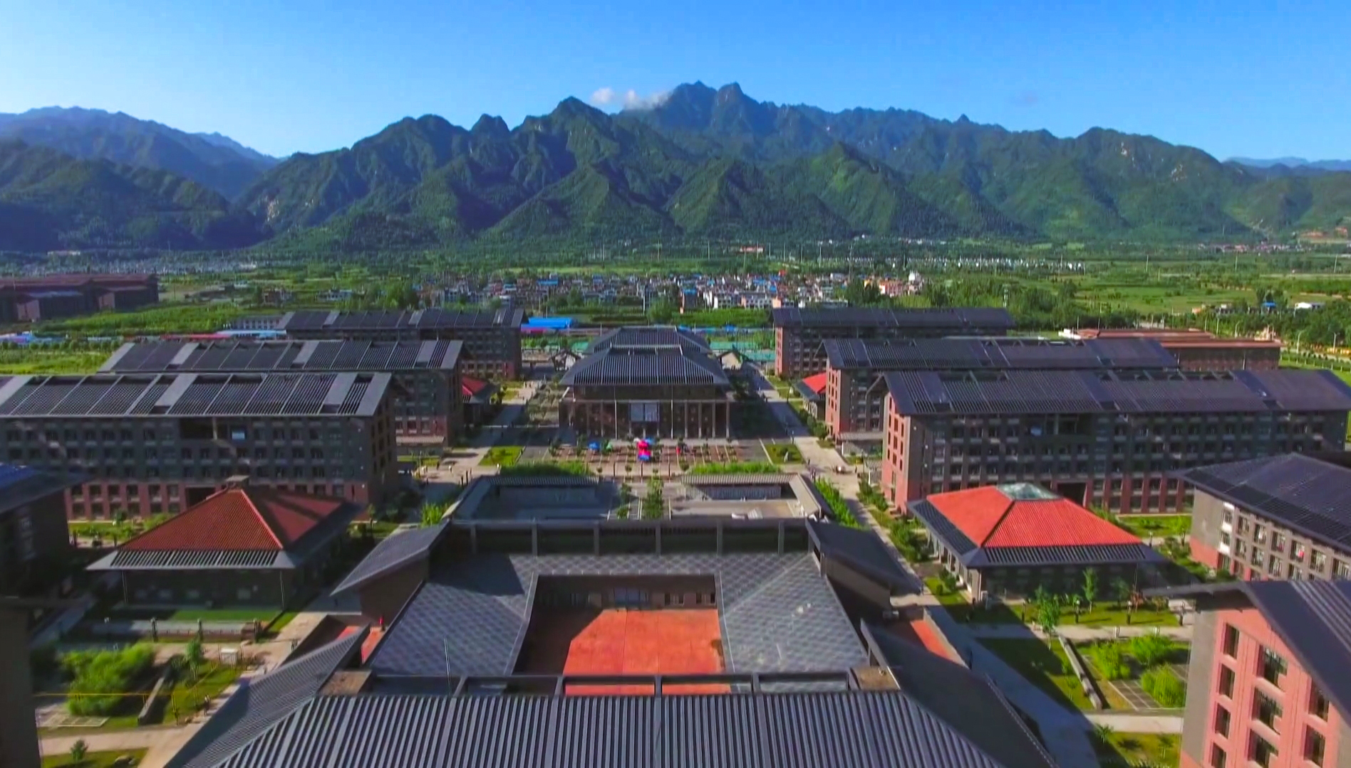

Oral Presentation for
Doctoral Position
Niu Luyu
Xi’an, Shaanxi
Xi'an university of Arch & Tech
Notes:
Hello professor Yang, This is my oral xxx

Slide 2

XXCC
01 Edu Background
02 Research Interests
Content
03 Research Experience
04 Future Plan
Notes:
I will introduce myself in 4 ways.

Slide 3
1 Education Background
Home： Xi’an | Toefl: 90
EDUCATION
University: Xi’an University of Architecture and Technology
2018/09-2022/07 | Environmental & Municipal Engineering | Bachelor | 3.41 (20%)
AWARD
03/2021 | 2nd Prize in 16th the National Environmental Science & Technology Competition
12/2022 | National Encouragement Scholarship (1 time/top 3%)
4 years | Merit Student of Xi'an University of Architecture and Technology (4 times/top 20%)
09/2021 | 3rd Prize in the National English Contest on school level (top 20%)
09/2021 | Outstanding Vice President of School History Society
PATEN
Notes:
Hello Doctor Yang, my name is Niu Luyu. In 2022, I received a bachelor's degree in environmental science from Xi'an University of Architecture and Technology. I achieved the top 20% grades, and our class has the highest GPA among three classes. At the same time, I received a scholarship of more than 10,000 ten thousand yuan (rmb) in four years. In addition, I also pubulished three national patents, one provincial award, and two national awards.

Slide 4
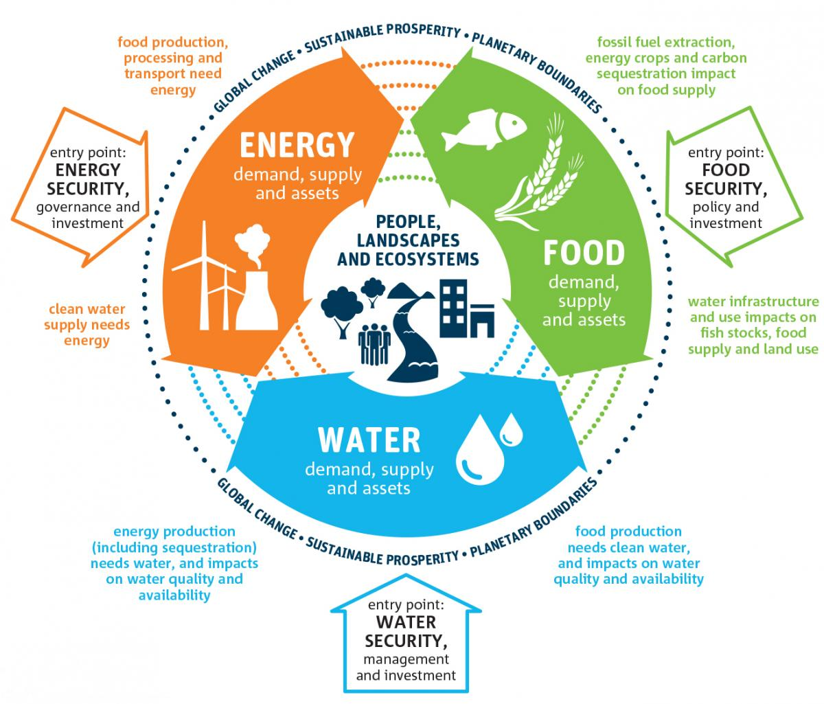
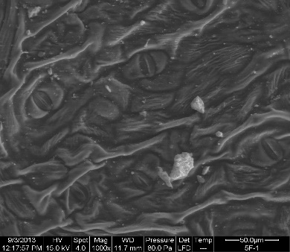
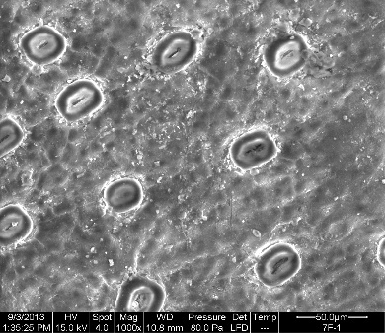

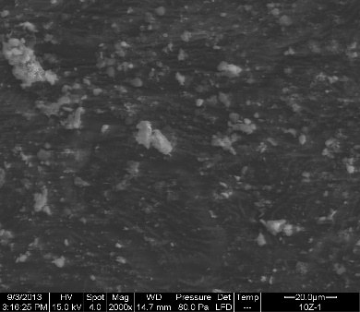
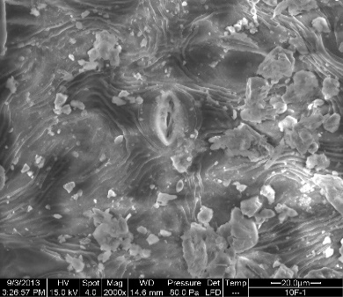

2 Research Interests
[1]
Statistical analyses
&
Model development
Water-food-energy
Nexus
Dust-detaining of
Ground Cover Plants
[1] Hatfield-Dodds, S., Schandl, H., Adams, P. et al. (2015) 'Australia is ‘free to choose’ economic growth and falling environmental pressures', Nature, 527, pp. 49–53. https://doi.org/10.1038/nature16065.

Slide 5
3 Research Experience
RESEARCH
07/2020 | Dry Settlement Rates and Influencing Factors of Different Diameter Particles in the Air on Plant Leaves
07/2022 | Establishment and Application of Water Supply-Energy-Food Model Based on Multiple Reservoirs
12/2021 | Zero-carbon Membrane Technology Equipment for High Salinity Oilfield Well Water Treatment
PATENT
09/2021 | An Experimental Device for Forward Osmosis Membrane Water Treatment | Utility Model Patents
06/2021 | An Experimental Device and Method for Forward Osmosis Membrane Water Treatment | Invention Patent
11/2021 | An On-Site Atmospheric Detection Collector Device for Multi-parameter Tasks | Utility Model Patents

Slide 6
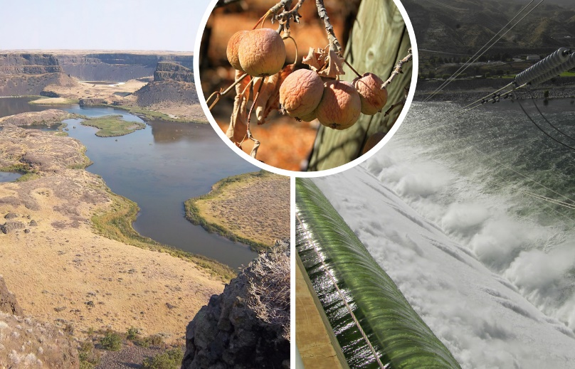

3.1 Establishment and Application of Water Supply-Energy-Food Model Based on Multiple Reservoirs
Background
Content
Uncertainty
Water supply
Surplus water
Available water
It can process the probability distribution information of available water;
Dealing with errors due to uncertainty ;
The prediction accuracy is higher
Method
Aim
Two-stage stochastic programming
BP neural network
Water allocation policy
Optimal food production and power generation
Model
Water Supply-Energy-Food Model Based on Multiple Reservoirs
Total system benefit

Slide 7
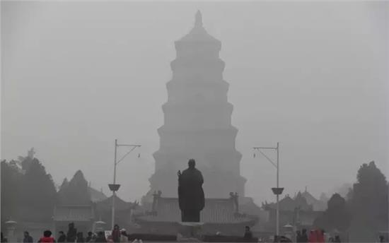
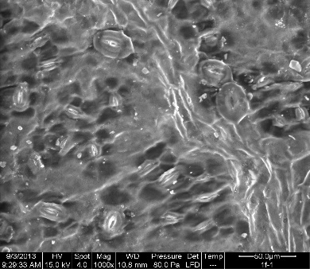
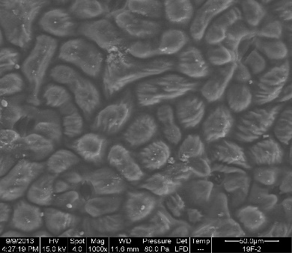
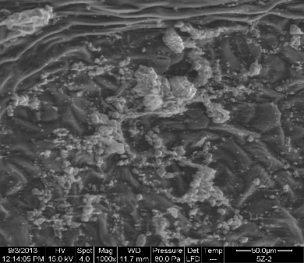
3.2 Dry Settlement Rates and Influencing Factors of Different Diameter Particles in the Air on Plant Leaves
Background
Content
Factors
Pore area
Pore Density
Groove width
Aim
Finding the Equational Relationship Between Multiple Independent Variables(x) and Dependent Variables(y);
Reduce unnecessary independent variables(x);
Improve air quality
Method
Look for tree species with strong dust retention ability
Find the decisive factor
Model
Multiple linear regression
Principal Component Analysis

Slide 8
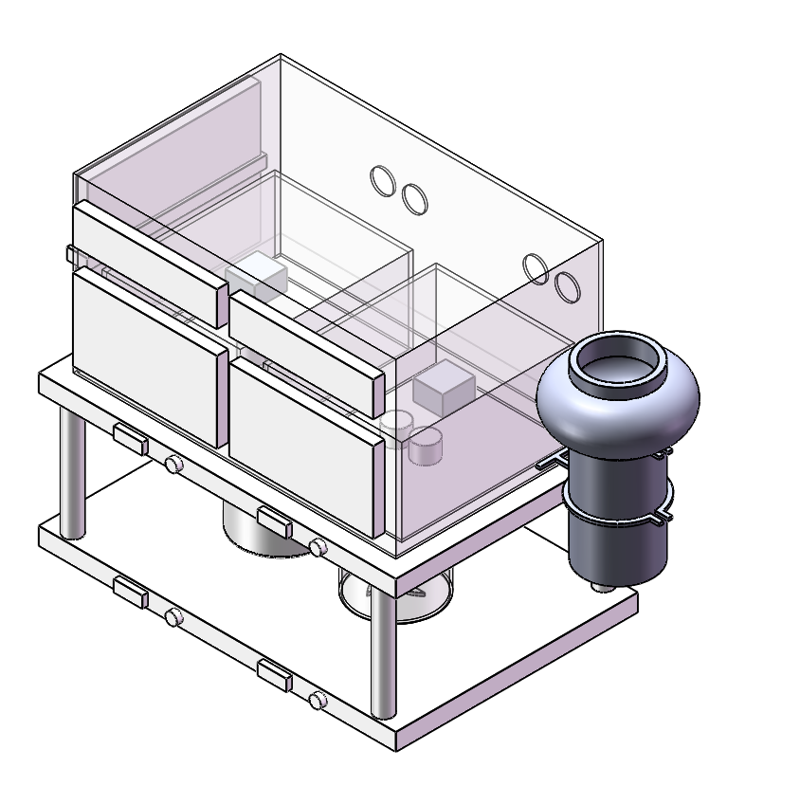
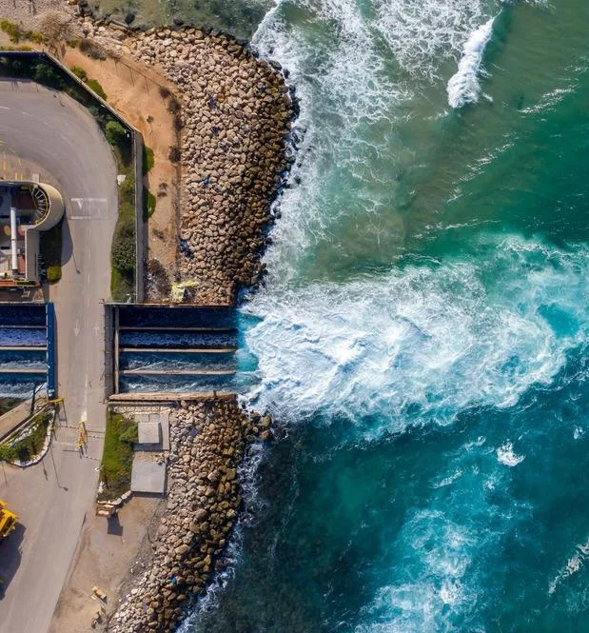
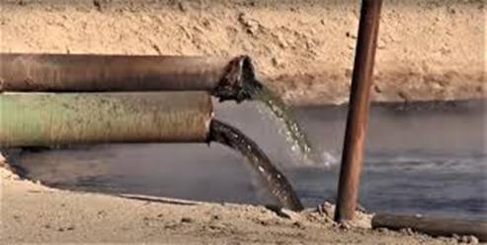
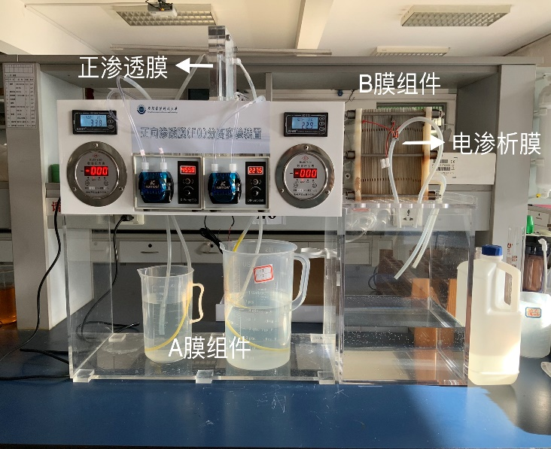
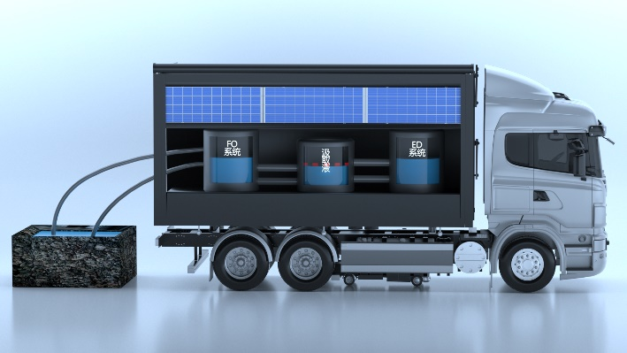
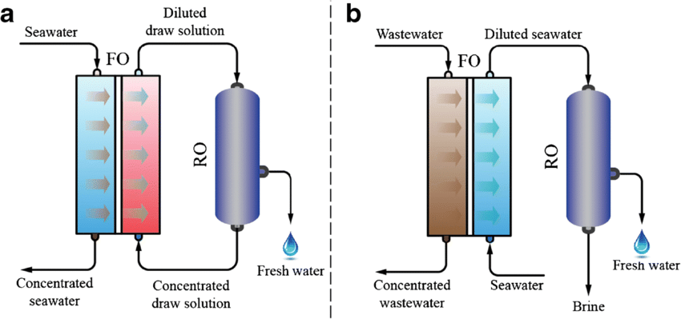
3.3 Zero-carbon membrane technology equipment for high salinity oilfield well water treatment & Patent: China, CN202120630733.9
Background
Achievement
Forward osmosis membranes (FO)
Technology
Reverse osmosis membranes (RO)
Electrodialysis membrane
Principle
Product
[2]
[2] Duong, H.C., Ansari, A.J., Nghiem, L.D. et al. Low Carbon Desalination by Innovative Membrane Materials and Processes. Current Pollution Report 4, 251–264 (2018). https://doi.org/10.1007/s40726-018-0097-5

Slide 9
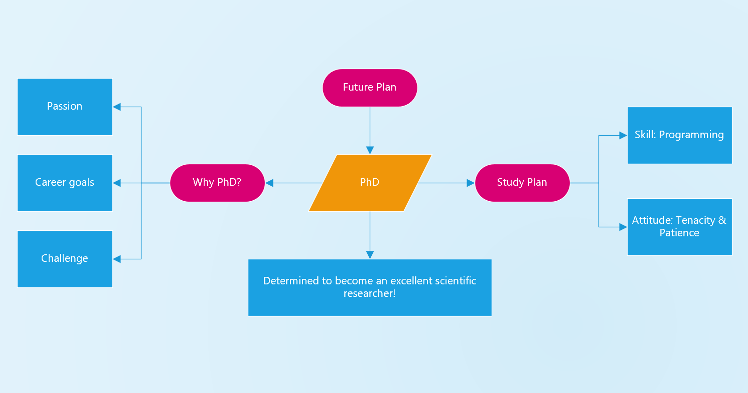
4 Future Plan

Slide 10
Thanks!

Slide 11
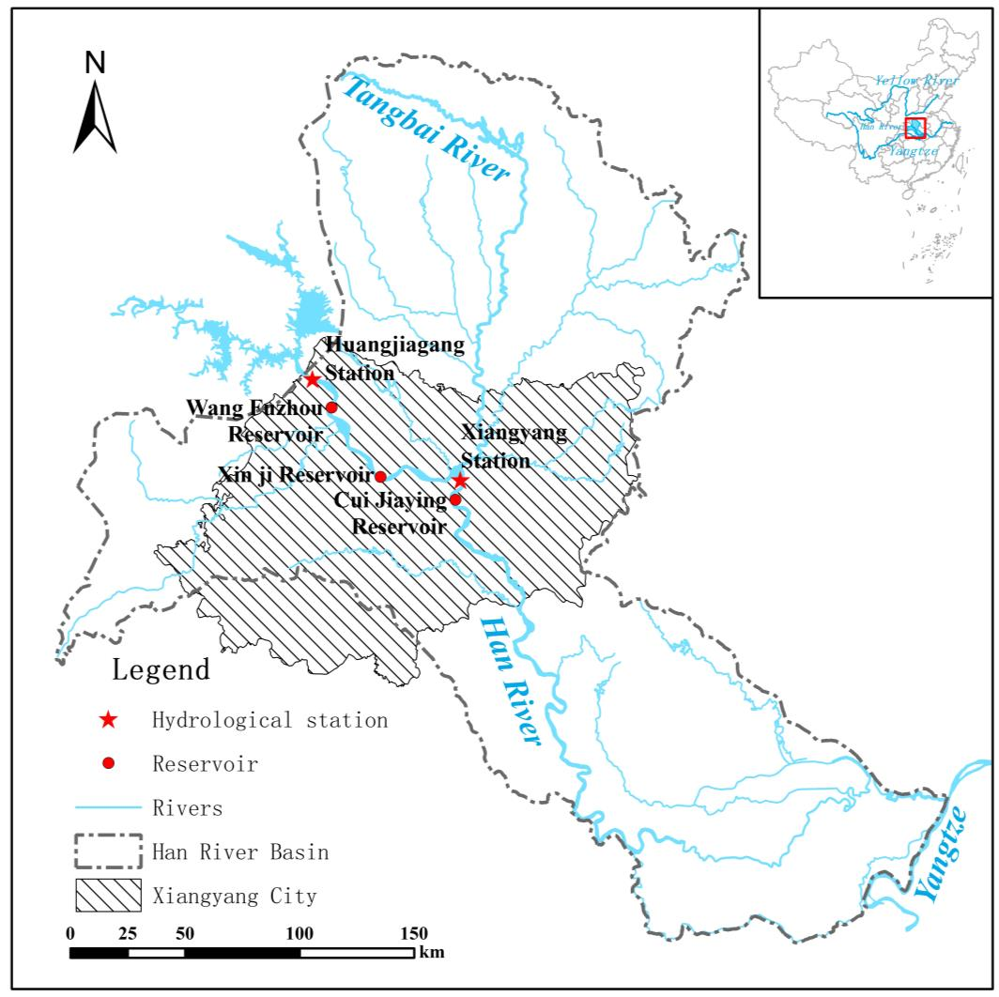
5 Potential question - reservoir - location
Wang Fuzhou reservoir - WFZ
Xin ji Reservoir - XJ
Cui Jiaying Reservoir – CJY
Take the three reservoirs as a whole.

Slide 12
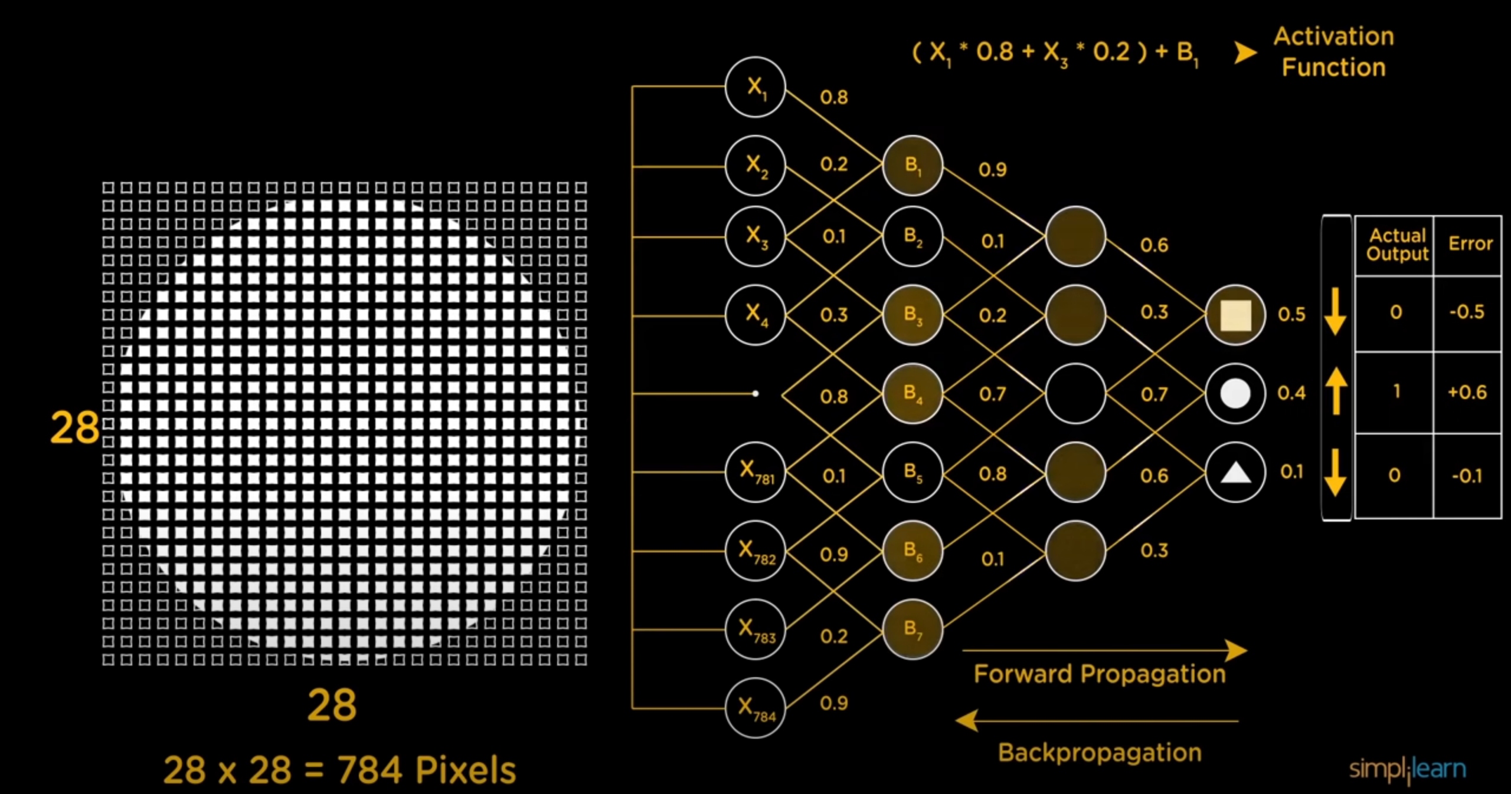
5 Potential question - reservoir – neural network

Slide 13
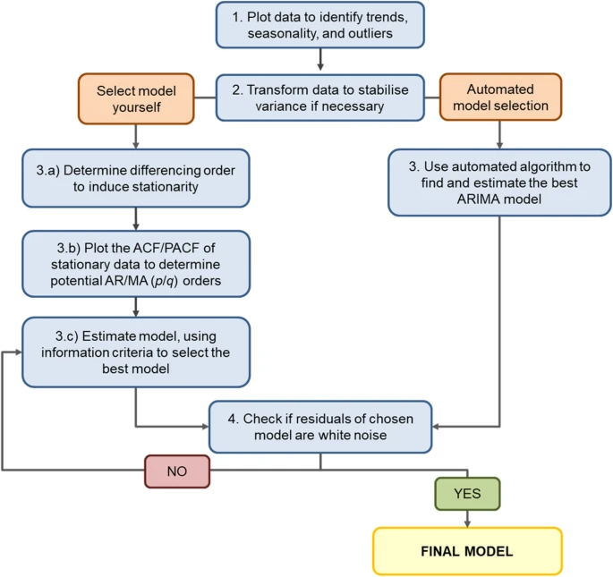
5 Potential question - reservoir - Arima
Arima(p, d, q) - autoregressive integrated moving average (ARIMA) models
Premise: Stationarity: The mean and variance of the sequence do not change significantly
The model only needs endogenous variables. (The so-called endogenous variables should only depend on the data itself, unlike regression that requires other variables)
AR(p) – PACF
MA(q) – ACF
If there is a trend, a first order difference is required and d = 1. If there is seasonality, a seasonal difference is required and D = 1.

Slide 14
5 Potential question - reservoir - resource
Table 1. Date Sources
Table 2. Date Sources
Data Name | Data Sources | Data Prediction
Rainfall | Xiangyang hydrological yearbook | ARIMA model
Reservoir Evaporation | Literature [31] | Mean-Variance Model
Resident population of Xiangyang (10,000 people) | the National Bureau of Statistics of China http://www.stats.gov.cn/ | Deep Neural Networks
Industry Expected Unit Earnings | Xiangyang City 14th Five-Year Plan formulation ⁽¹⁾ | SPSS expert modeler
Agricultural Expected Unit Earnings | Xiangyang City 14th Five-Year Plan formulation ⁽¹⁾ | SPSS expert modeler
Municipal Expected Unit Earnings | Xiangyang City 14th Five-Year Plan formulation ⁽¹⁾ | SPSS expert modeler
Power Generation Expected Unit Earnings | Xiangyang City 14th Five-Year Plan formulation ⁽¹⁾ | SPSS expert modeler
Reservoir Output Coefficients | Literature [30] | No prediction required
Industrial Expected Water Supply | 2010, 2014-2020 Xiangyang Hydrological Yearbook | SPSS expert Modeler
Data Name | Data Sources |  | Data Prediction
Agricultural Expected Water Supply |  | 2010, 2014-2020 Xiangyang Hydrological Yearbook | SPSS expert modeling
Municipal Expected Water Supply |  | 2010, 2014-2020 Xiangyang Hydrological Yearbook | SPSS expert modeling
Power Generation Expected Water Supply |  | 2010, 2014-2020 Xiangyang Hydrological Yearbook | SPSS expert modeling
Difference of Water Head |  | Department of Ecology and Environment of Hubei Province (http://sthjt.hubei.gov.cn/)⁽²⁾ | No prediction required
Inbound and Outbound flow of Cui Jiaying Navigation Power Water Project |  | Literature [35] [36] | ARIMA Model
Inbound and Outbound flow of Wang Fuzhou Navigation Power Water Project |  | Literature [35] [36] | ARIMA Model
Inbound and Outbound flow of Xinji Navigation Power Water Project |  | Literature [35] [36] | ARIMA Model
The catchment area of the Wangfuzhou dam site |  | Literature [37] | No prediction required
The catchment area of the Xinji dam site |  | Literature [37] | No prediction required

Slide 15
5 Potential question - reservoir - model
Total system benefit
Table 3. subscript
Name | Meaning
t | t=1: 2025, t=2: 2028, t=3: 2031, a total of three planning periods
h | Water flow level: h=1 low water level, h=2 medium water level, h=3 high water level
j | Reservoirs: j = 1 Xinji Reservoir (XJ), j = 2 Wangfuzhou Reservoir (WFZ), j = 3 Cuijiaying Reservoir (CJY)
According to the "Hydrological Yearbook of Xiangyang City," the 16-year rainfall evaluation division of Xiangyang City from 2005 to 2020 can be known.
If both the dry and abundant water levels are considered as the h = 2 water level, the median probability is 81.25%;
If the abundant water level is considered as the h=3 water level, the high probability is 12.50%;
If the low water level is considered as the h=1 water level, the low probability is 6.25%.

Slide 16
5 Potential question - reservoir - model
Table 4. Abbreviation
Meaning | Abbreviation
Two-stage stochastic programming model parameters
Agriculture/Industry/Municipality/hydropower generation expected unit benefit (100 million yuan) | BA_{th}, BI_{th}, BM_{th}, BH_{th}
high head | Hs
Low head | Ha
head difference | h_change
Expected water supply for Agriculture/Industry/Municipality/hydropower generation (100 million cubic meters) | EA_{th}, EI_{th}, EM_{th}, EH_{th}
Industrial expected unit loss (100 million yuan) | BDH_{th}
Net loss for municipality/agriculture/industry per volume of water not being delivered from reservoir j in period t | BDM_{th}, BDA_{th}, BDI_{th}
Reservoir coefficient^{[40]} | Usα
Probability coefficient | P_{htj}
Water shortage for agriculture/industry/municipality/ from reservoir j in period t (m 3 ) | DA_{th}, DI_{th}, DM_{th},
Water shortage for hydropower generation from reservoir j in period t (m 3 ) | DH_{th}
Loss of flood water for municipality/agriculture/industry/ecology/electricity per volume of water being delivered from reservoir j in period t (RMB ¥/m 3 ) | LA_{th}, LI_{th}, LIM_{th}, LH_{th}
Surplus water (in flooding season) for municipality/agriculture/industry/ecology/electricity from reservoir j in period t (m 3 ) | FA_{th}, FI_{th}, FM_{th}, FH_{th}
Pink: Output

Slide 17
5 Potential question - reservoir - model
Total system benefit
Water balance:
Inflow － Outflow ＝ Change in Storage
Table 5. Abbreviation
Meaning | Abbreviation
water mass balance in CJY/XJ/WFZ reservoir | R¹_{thj}, R²_{thj}, R³_{thj}
Rainfall in CJY/XJ/WFZ Reservoir | Q¹_{th}, Q²_{th}, Q³_{th},
Inflow of CJY/XJ/WFZ Reservoir | S¹_{th}, S2_{th}, S3_{th}
Outflow of CJY/XJ/WFZ Reservoir | S¹_{(t+1)h}, S²_{(t+1)h}, S³_{(t+1)h}
Evaporation of CJY/XJ/WFZ Reservoir | E¹_{th}, E²_{th}, E³_{th}
The water surface area of CJY/XJ/WFZ Reservoir | A¹_{th}, A²_{th}, A³_{th}
Natural Evaporation of CJY/XJ/WFZ Reservoir | E¹_{th,nature}, E²_{th,nature}, E³_{th,nature}

Slide 18
5 Potential question - reservoir - model
Total system benefit
Table 6. Abbreviation
Meaning | Abbreviation
Channel biological storage of 1/3 (CJY+XJ+WFZ) Reservoir | H_{thj}
Channel Evaporation of CJY/XJ/WFZ Reservoir | G_{thj}
Total available water volume of CJY/XJ/WFZ Reservoir | V¹_{thj}, V²_{thj}, V³_{thj},

Slide 19
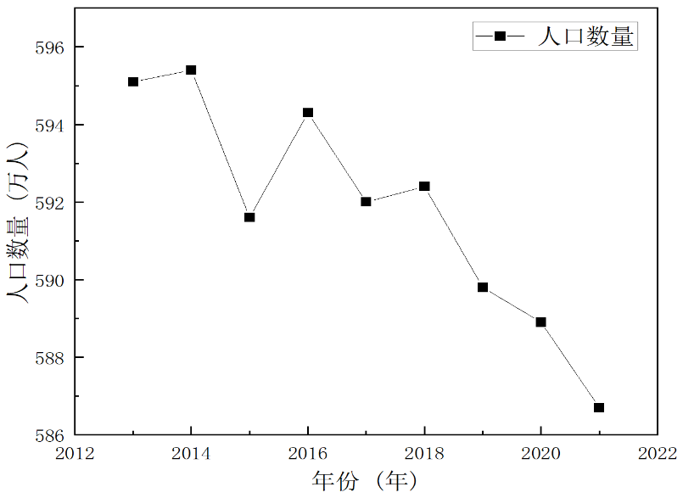
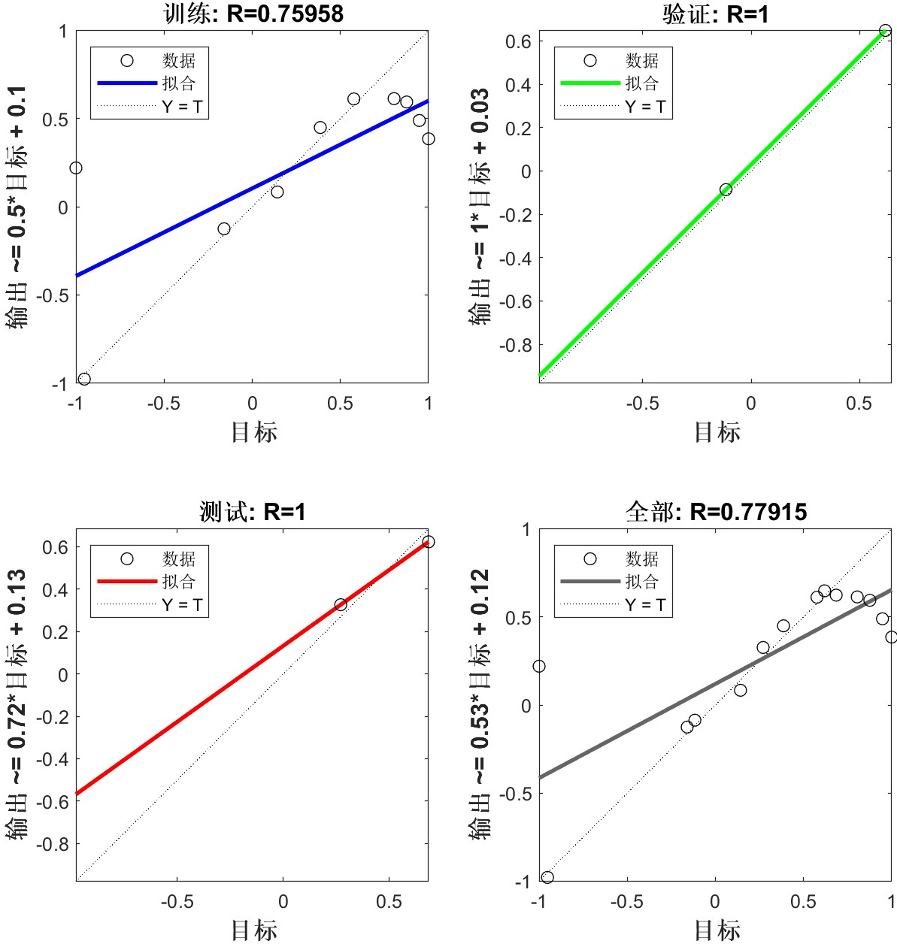
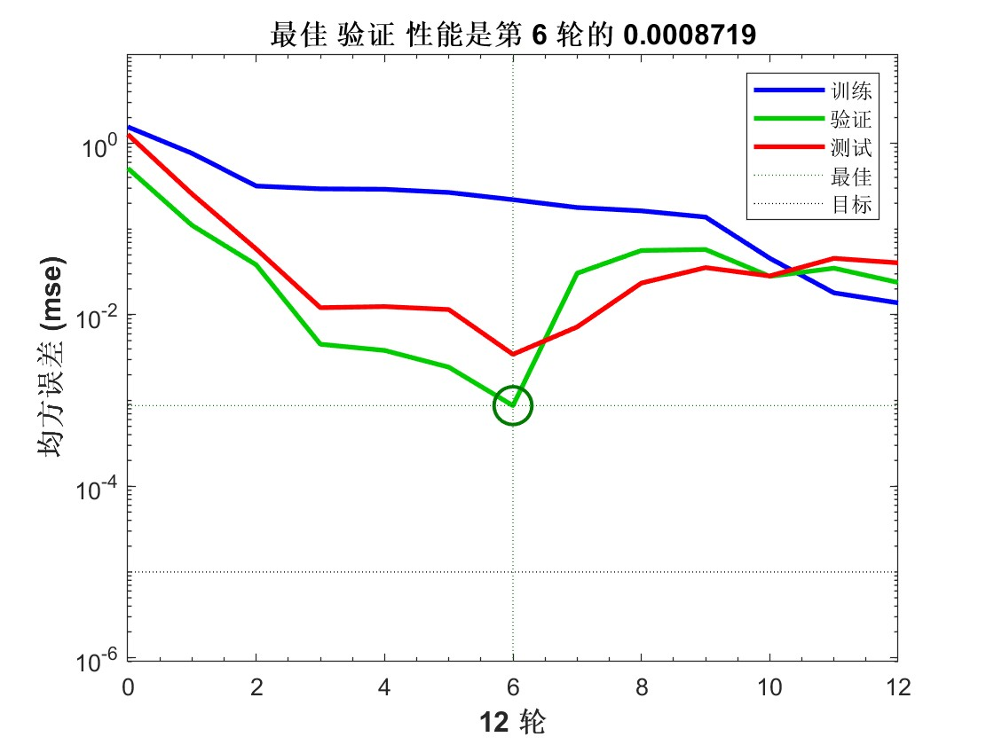
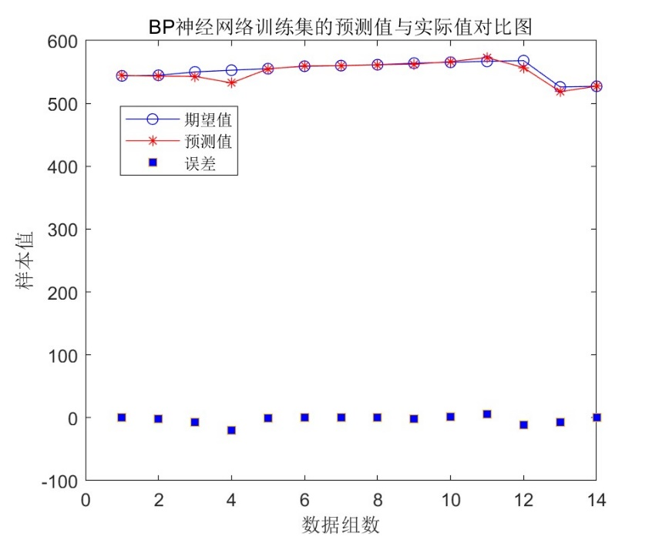
5 Potential question - reservoir - BP
Set 1000 rounds of training, the best result is the 6th round of training.
The three colored curves correspond to the training, testing and validation sets respectively.

Slide 20
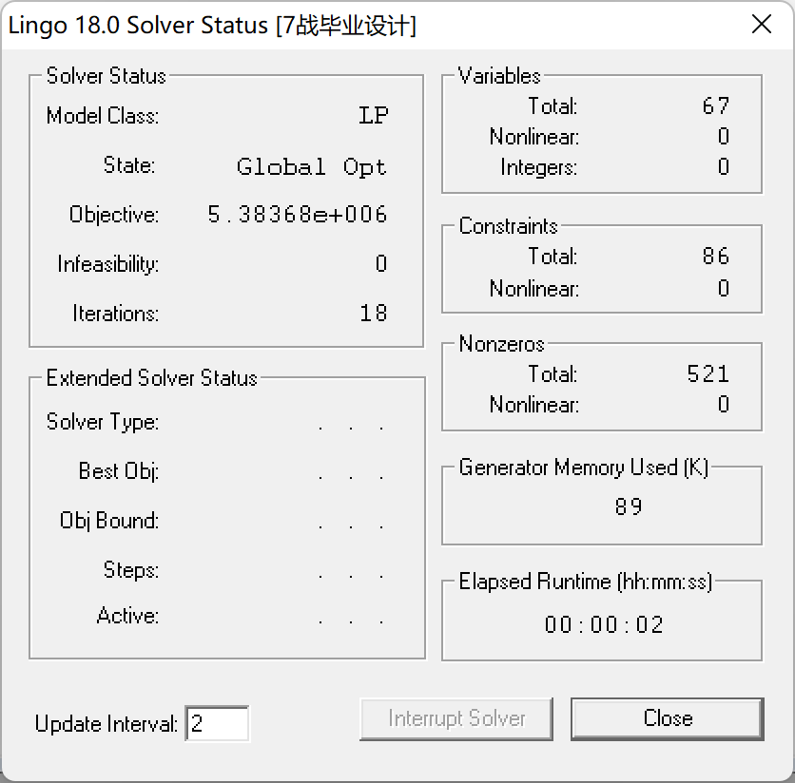
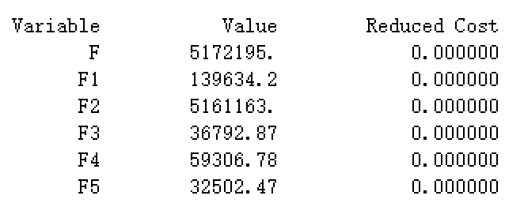
5 Potential question - reservoir - result
Figure 1.Lingo program results
Figure 2. Losses and Revenues in Different Sectors
F is the sum of agricultural, industrial, power generation, and municipal revenues minus penalties for the past three years.
F1 solves the sum of the benefits of water supply for agriculture and industry in the three periods for the model;
F2 is the model to solve the sum of the income generated by water supply to power generation in the three periods;
F3 solves the sum of agricultural and industrial losses caused by failure to reach the expected water supply in the three periods for the model;
F4 solves for the model the losses caused by failure to reach the expected water supply and power generation in the three periods;
F5 solves the sum of agricultural and industrial losses caused by exceeding the expected water supply in the three periods for the model.

Slide 21
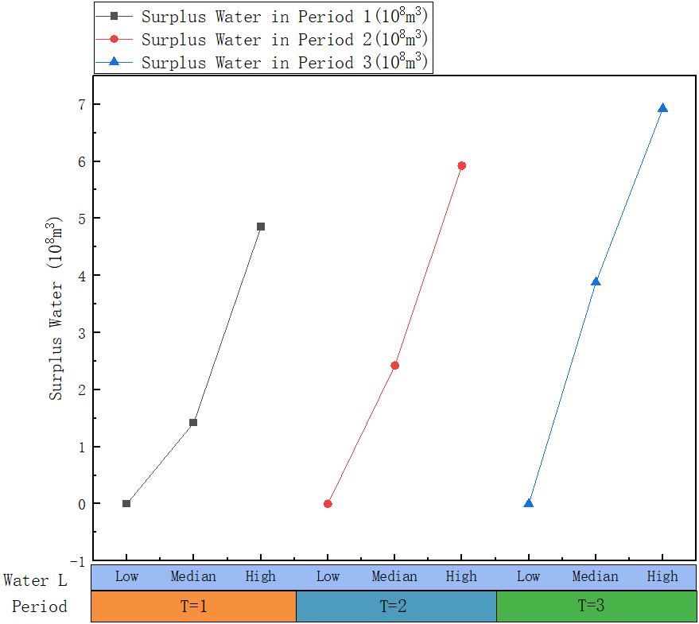
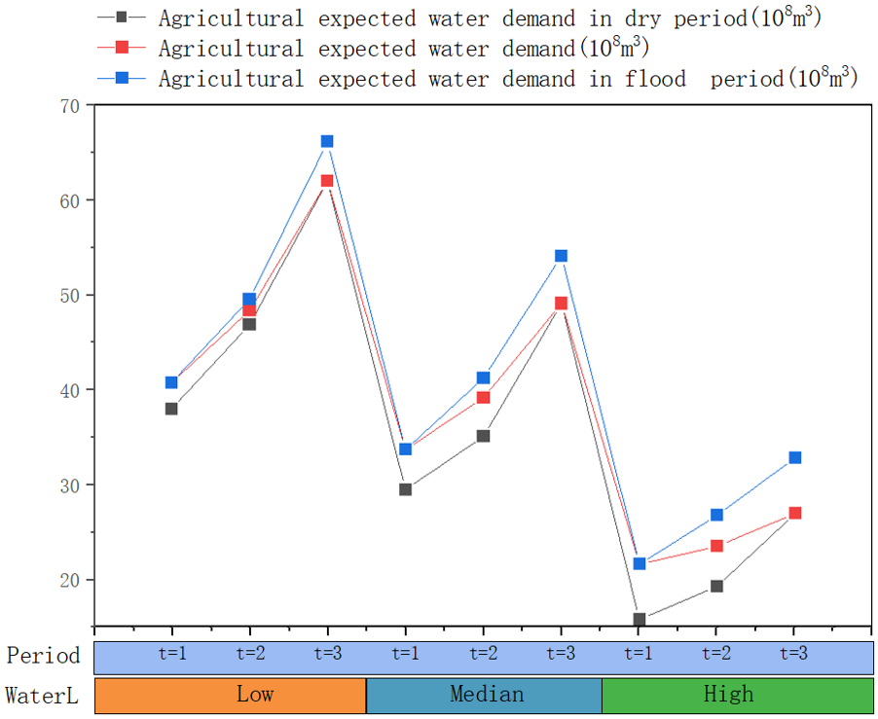
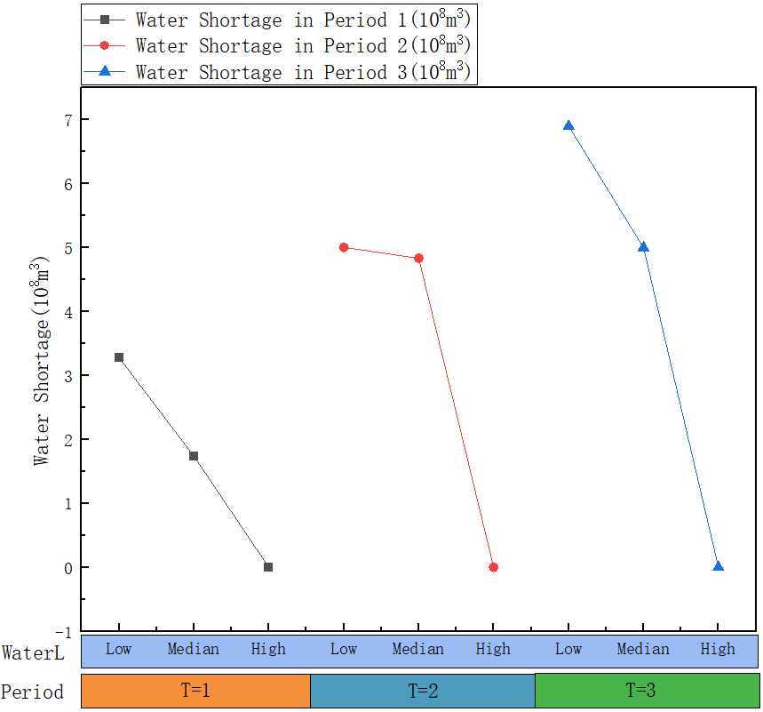
5 Result - Agricultural Water Demand
Figure 3. Agricultural expected water demand
Figure 4. Water scarcity value in three periods of agriculture
Figure 5. The surplus water in the three periods of agriculture
Expected water demand:
t3>t2>t1 L>M>H
Expected water shortage:
t1>t2>t3 L>M>H
Expected excess water:
t3>t2>t1 H>M>L
Because of the policy support and Xiangyang City regards agriculture as its key development industry. So the water demand increases with the period (T1->T2->T3), and the water demand increases.
When the water level in reservoir is high (H), the surplus water is the high and the water shortage is low (L), and vice versa.

Slide 22
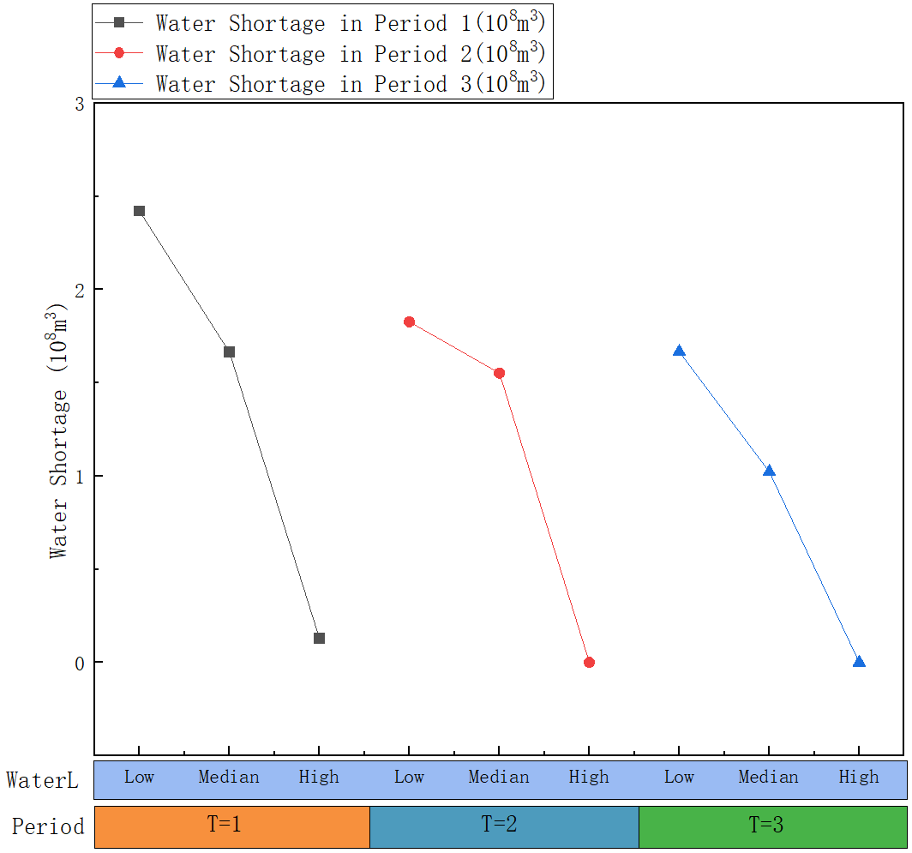
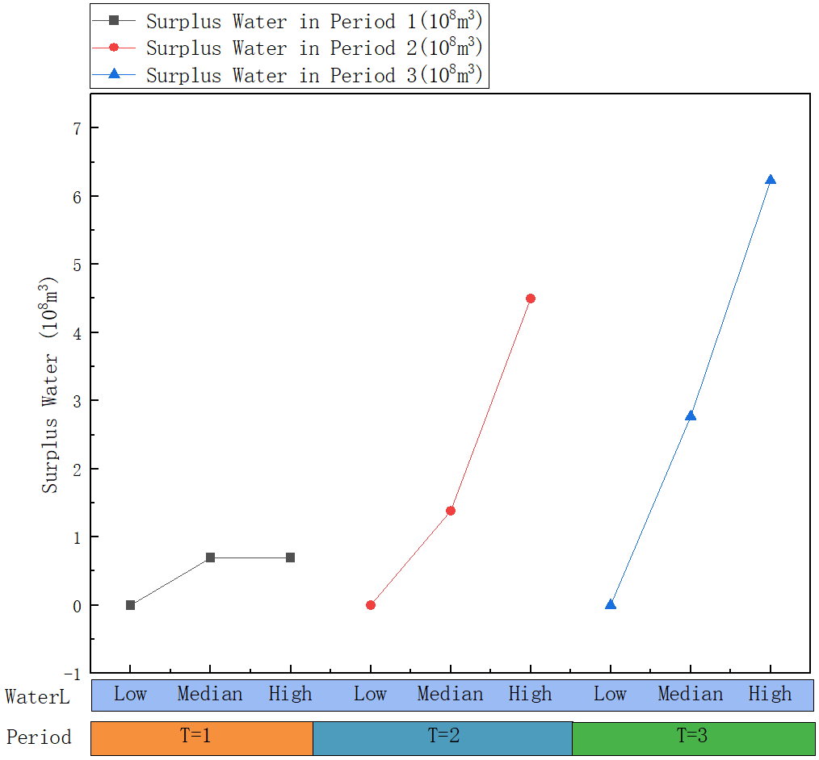
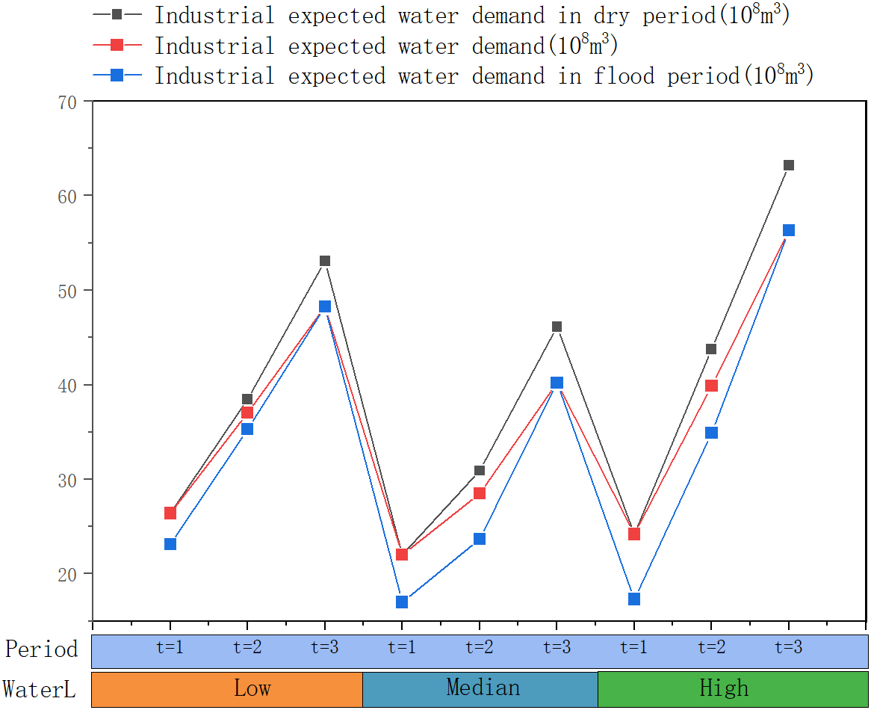
5 Result - Industrial Water Demand
Figure 6. Industrial expected water demand
Figure 7. Water scarcity value in three periods of industry
Figure 8. The surplus water in the three periods of industry
Expected water demand:
t3>t2>t1 L>M>H
Expected water shortage:
t1>t2>t3 L>M>H
Expected excess water:
t3>t2>t1 H>M>L
The industry has brought the highest GPA to Xiangyang City, and it is also the project that the government attaches the most importance to and has the greatest potential. So the water demand increases with the period (T1->T2->T3), and the water demand increases.

Slide 23
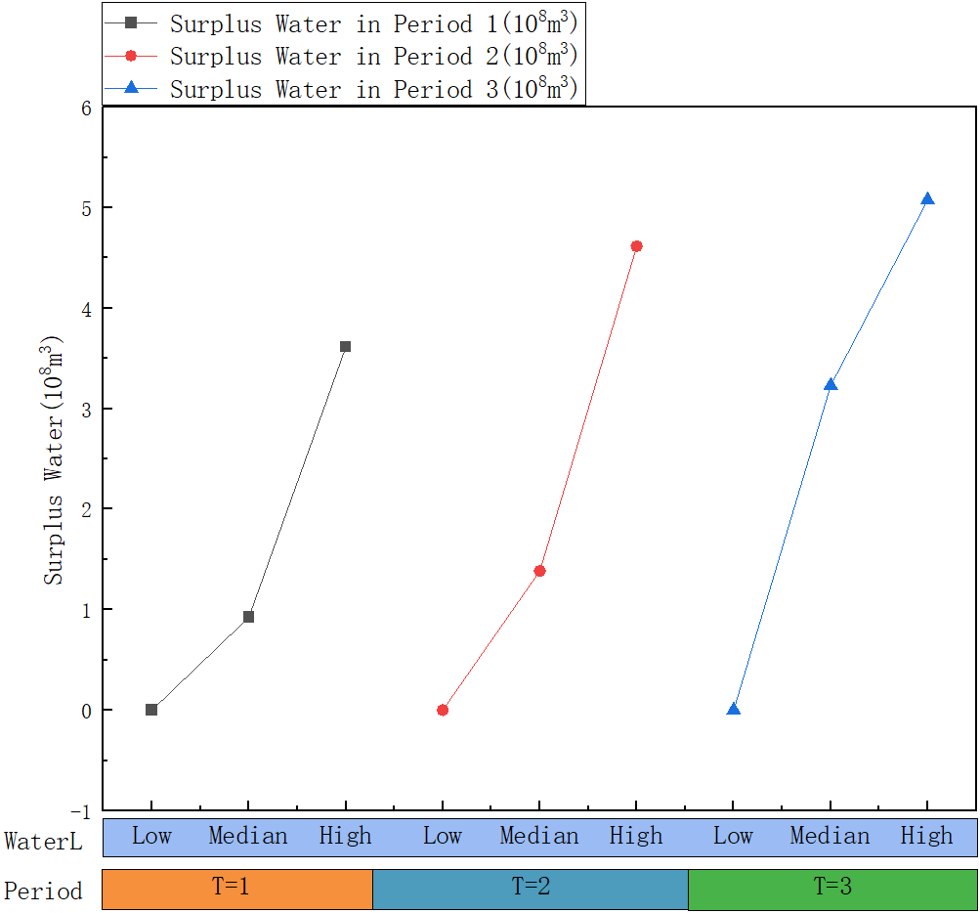
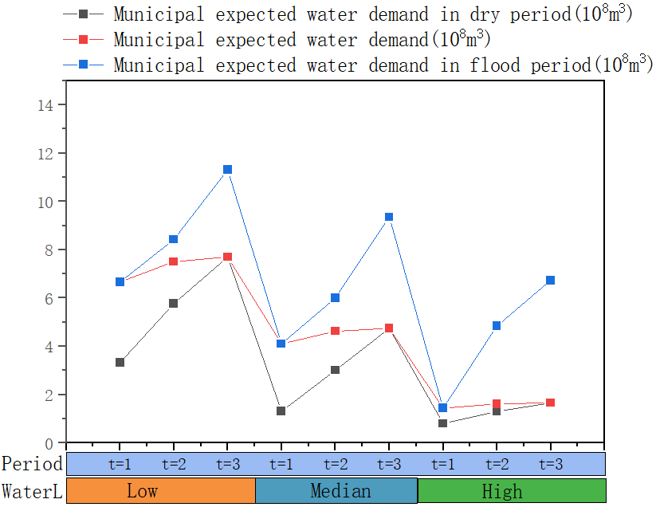
5 Result - Municipal Water Demand
Figure 9. Industrial expected water demand
Figure 10. Water scarcity value in three periods of industry
Figure 11. The surplus water in the three periods of industry
Expected water demand:
t3>t2>t1 L>M>H
Expected water shortage:
t1>t2>t3 L>M>H
Expected excess water:
t3>t2>t1 H>M>L
With the steady development of the municipal government and the increase of the period, the water demand has increased, but the rising trend is exhausted. It is because the resident population has decreased and the number of people needing water has decreased.

Slide 24
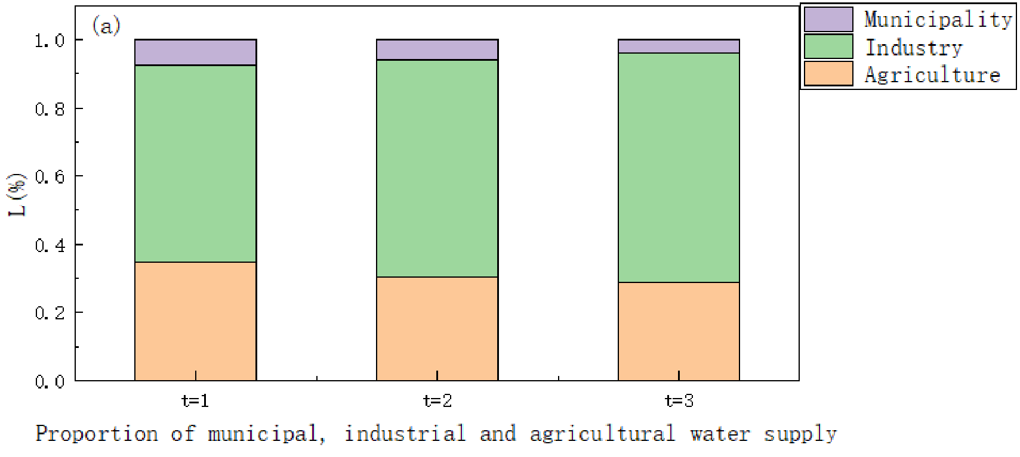
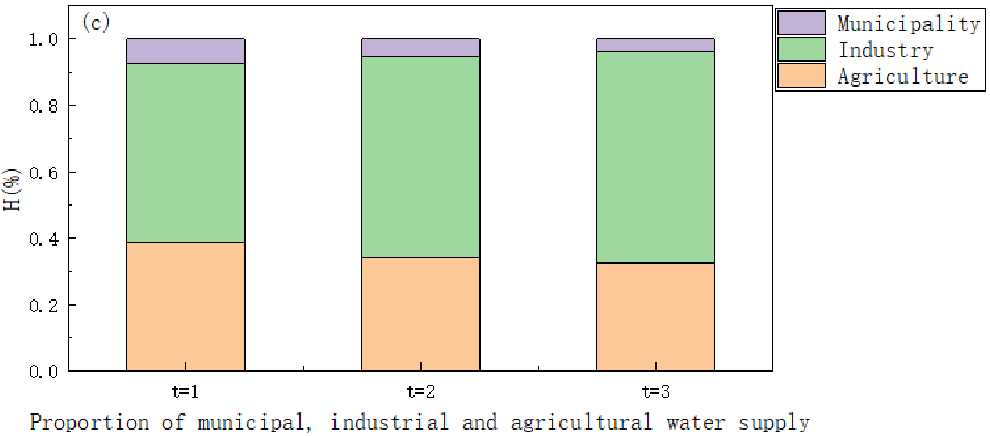
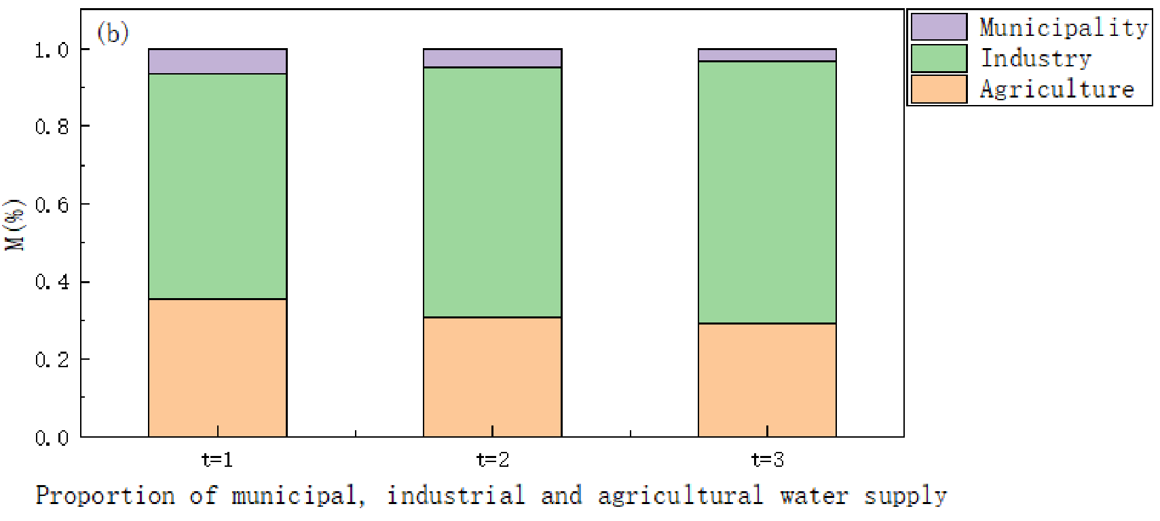
5 Result - Municipal Water Demand
Optimal ratio:
Agriculture > Industry > Municipal
Analyze:
The 14th Five-Year Plan pointed out that the proportion of agricultural water supply should be maintained and steadily increased; more efforts should be made to supply industries to achieve economic growth.
Figure 5-12 Water resource allocation ratio

Slide 25
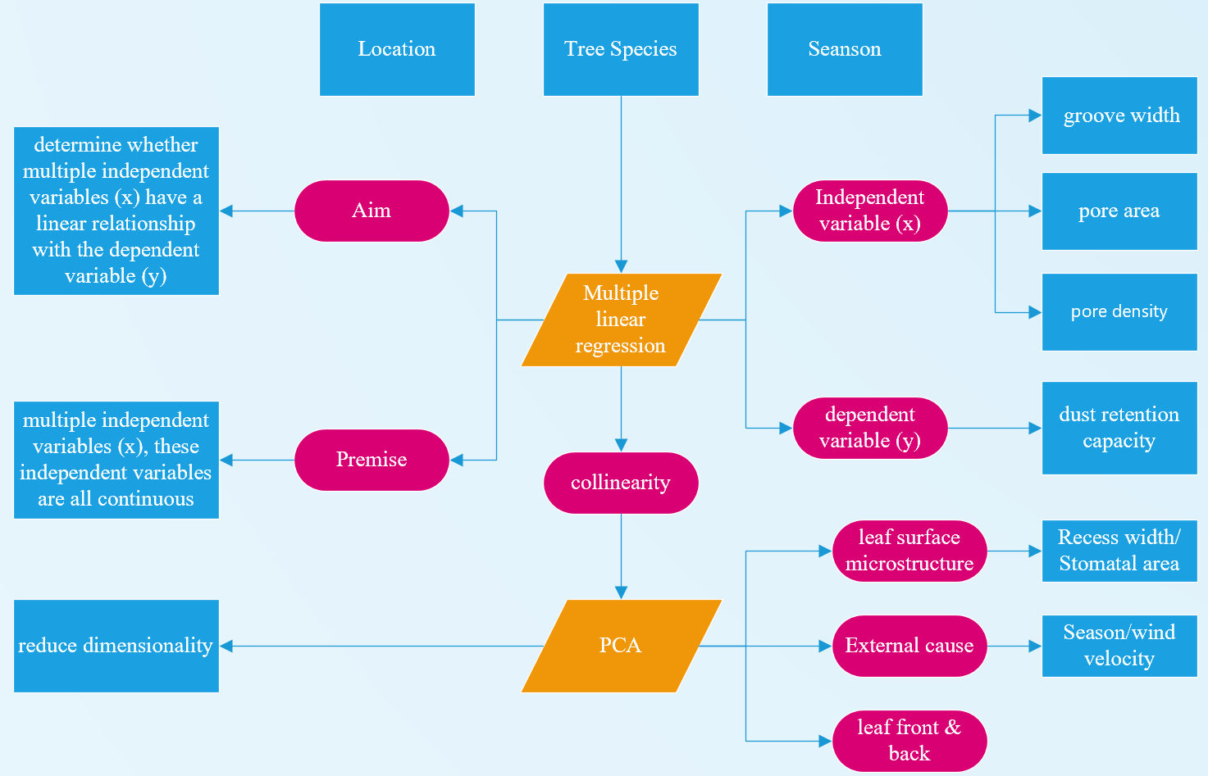
5 Potential question - Plant - Species
21

Slide 26
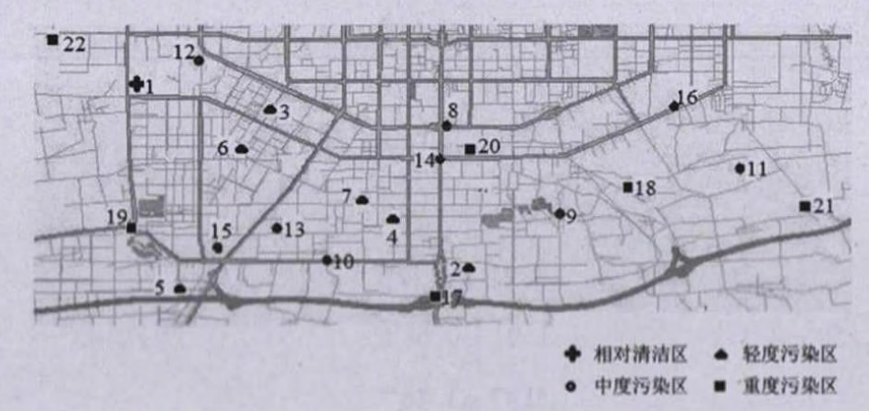
5 Potential question - Plant - location
Research Object: Taking the southern suburbs of Xi'an as the research object, the representative production area, the main traffic road, and the secondary arterial road section are the main research objects, with a total of 22 points. The distribution of the sample points is shown in Figure 1.
The traffic situation at the location of the sample point was investigated in three time periods of 7:00-9:00, 11:30-14:00, and 17:00-19:00, and the traffic flow was estimated based on continuous observation for 3 days.
According to the environmental conditions and traffic situation near the sampling point, it is divided into relatively clean area (CPF), lightly polluted area (LP), moderately polluted area (MLP) and heavily polluted area (SP).
Fig 13. The sampling sites

Slide 27
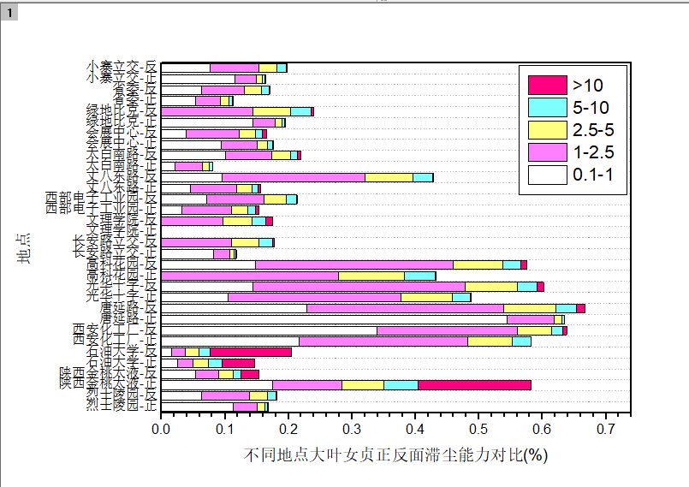
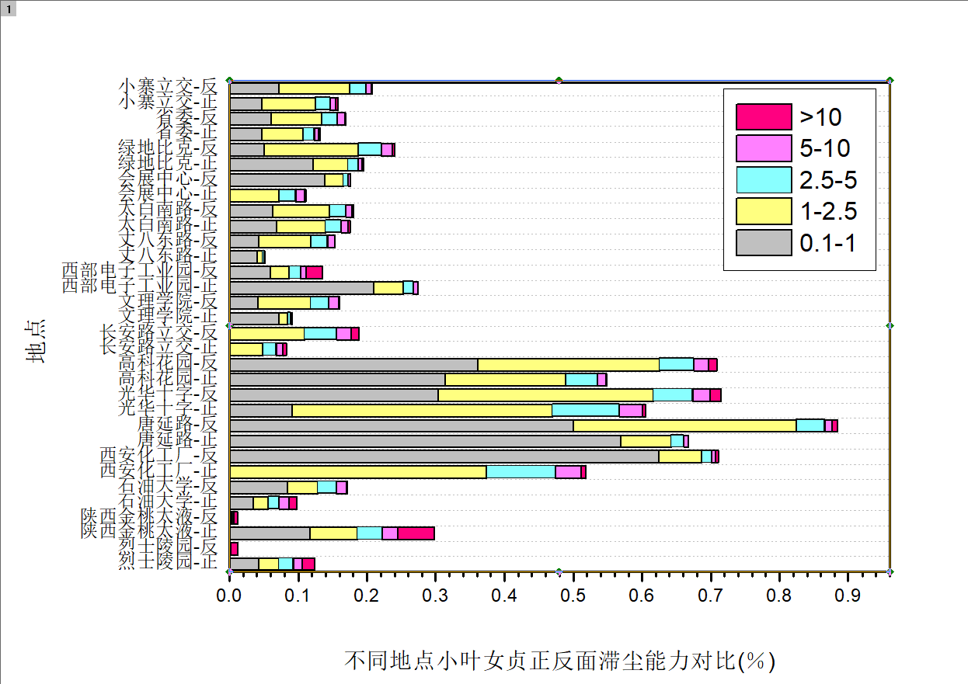
5 Potential question - Plant - Location
Fig 14. Ligustrum quihoui (small) dust holding capacity
Fig 15. Ligustrum lucidum (big) dust holding capacity
1) The amount of atmospheric particulate matter in the environment
2) The height at which plants are exposed to the atmosphere
3) Leaf surface microstructure

Slide 28
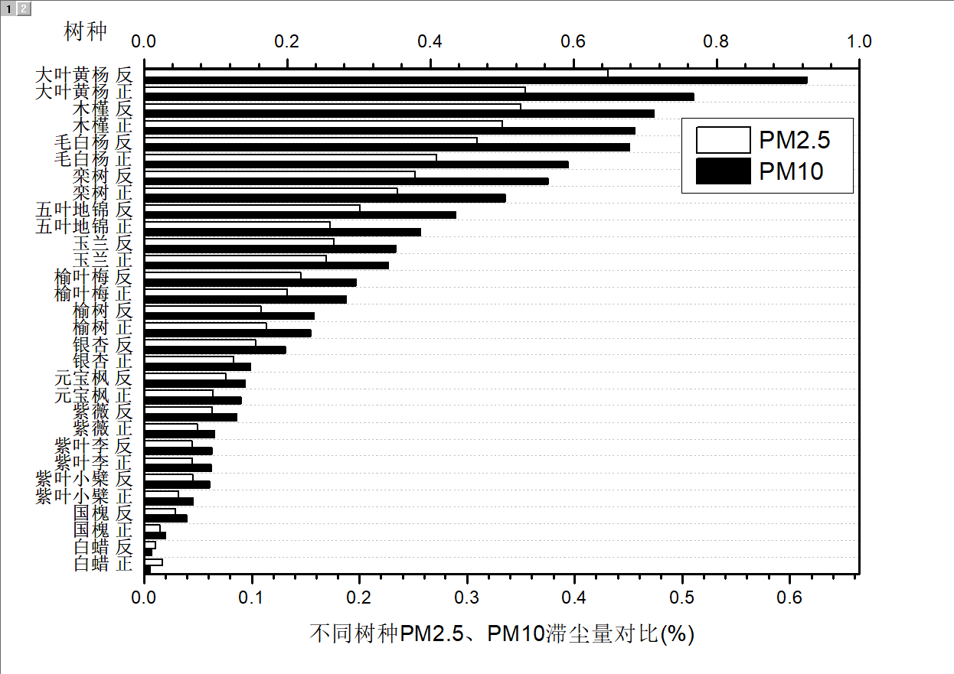
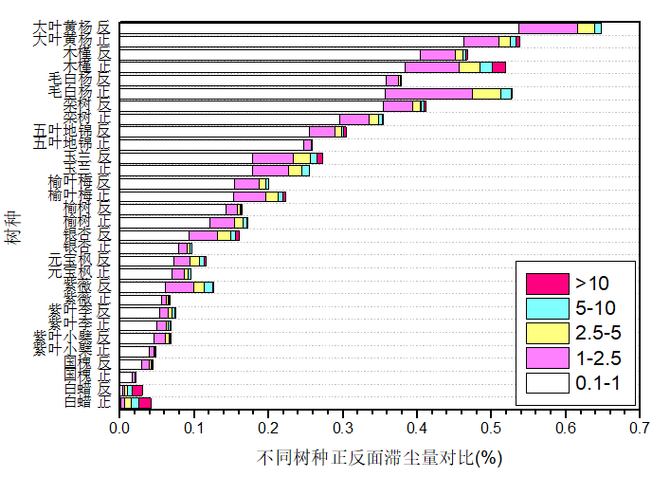
5 Potential question – Plant - Species
Buxus megistophylla Levl
Figure 16. Comparison of total dust holding capacity of leaves of different tree species
Figure 17. Comparison of the dust holding capacity of leaves of different tree species to PM_{2.5} and PM₁₀
It can be seen from Figure 16 that the order of the total dust retention capacity of leaves from large to small is: hibiscus > eucalyptus > poplar tomentosa > brocade > magnolia > elm leaf plum > elm tree > ginkgo > maple ingot > Lagerstroemia indica > Purple leaf plum > Purple leaf barberry > Chinese pagoda tree > White wax.
The leaves are mainly retained in fine particulate matter.
As shown in the figure 17, the order of the dust-retaining ability of different tree species to PM10 is: hibiscus > poplar tomentosa > eucalyptus > brocade > magnolia > elm plum > elm > ginkgo > maple ingot > crape myrtle > purple leaf Li > Berberis auricosa > Sophora japonica > White wax.
The change trend of dust retention capacity for PM_{2.5} is consistent with that of PM₁₀ dust retention capacity.

Slide 29
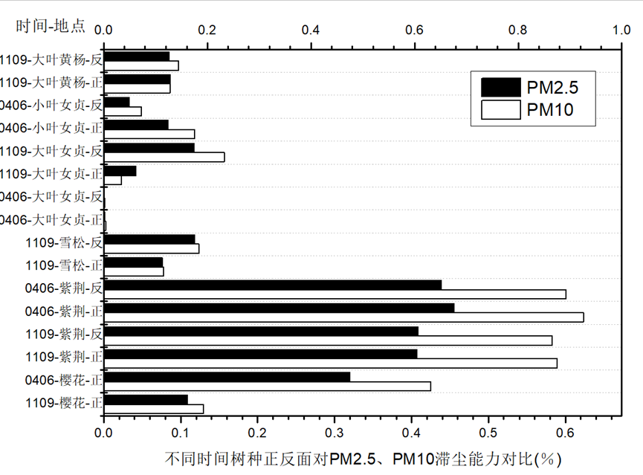
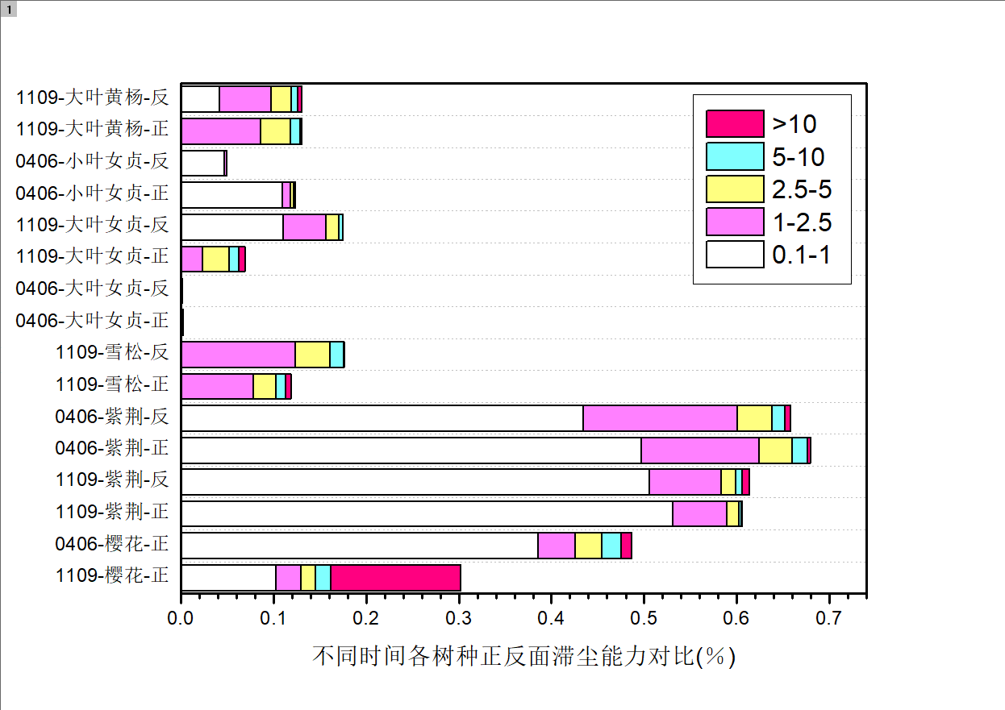
5 Potential question – Plant - Season
Fig 18. Comparison of front and back dust holding capacity of various tree species in different months
Fig 19. Comparison of PM2.5 and PM10 dust retention capabilities of various tree species in different months
1) The amount of atmospheric particulate matter in the environment
2) The height at which plants are exposed to the atmosphere
3) Leaf surface microstructure

Slide 30
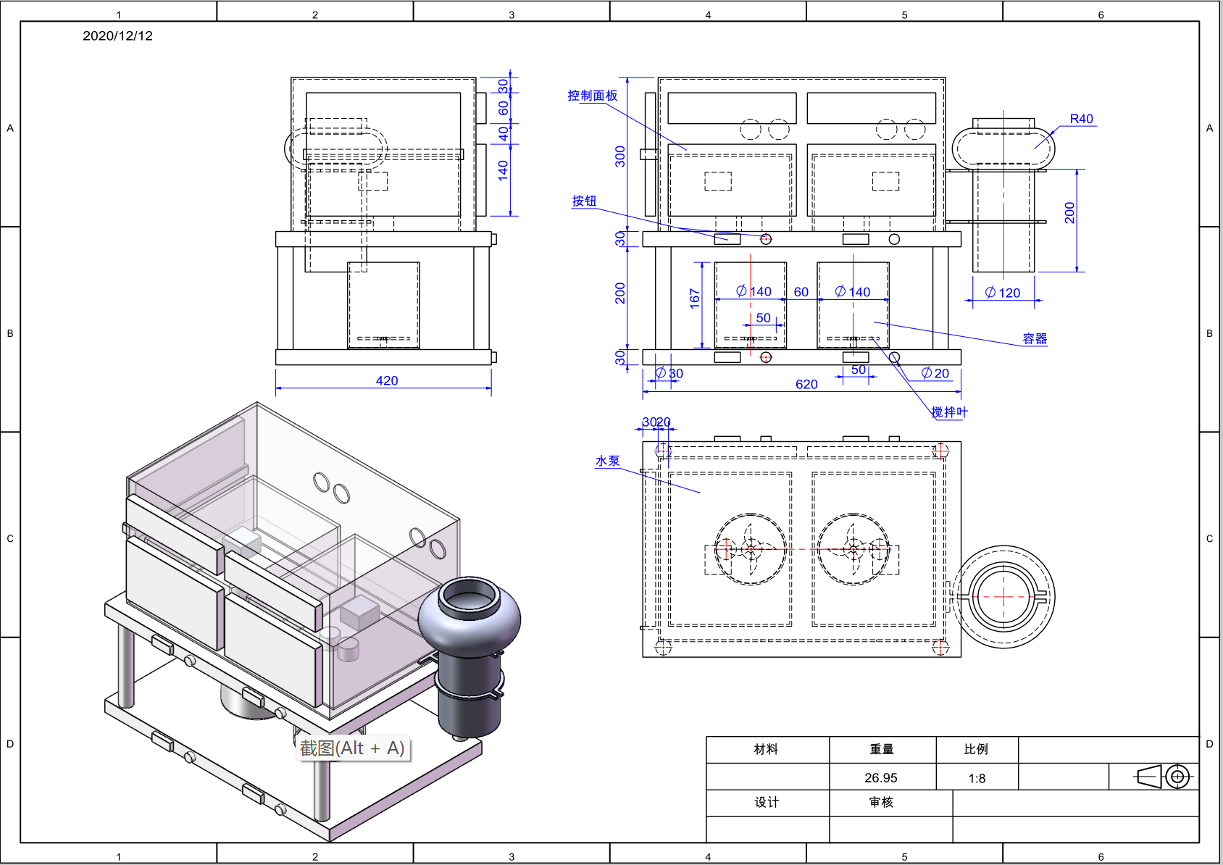
5 Potential question - patent
Prototype Device:
Software: CAD
Instructions: PRESSPULL + Spacebar
Control panel:
Control the flow rate, adjust the flow rate
conductivity meter,
Peristaltic pump
Electronic balance
control panel
RO
Electronic balance
container
mixer
FO
water pump

Slide 31
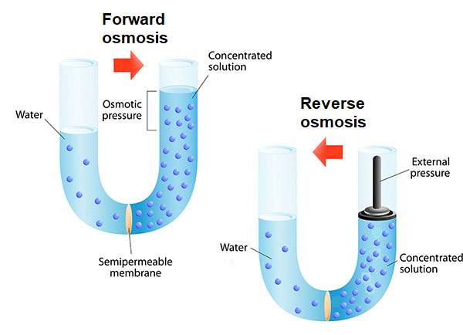
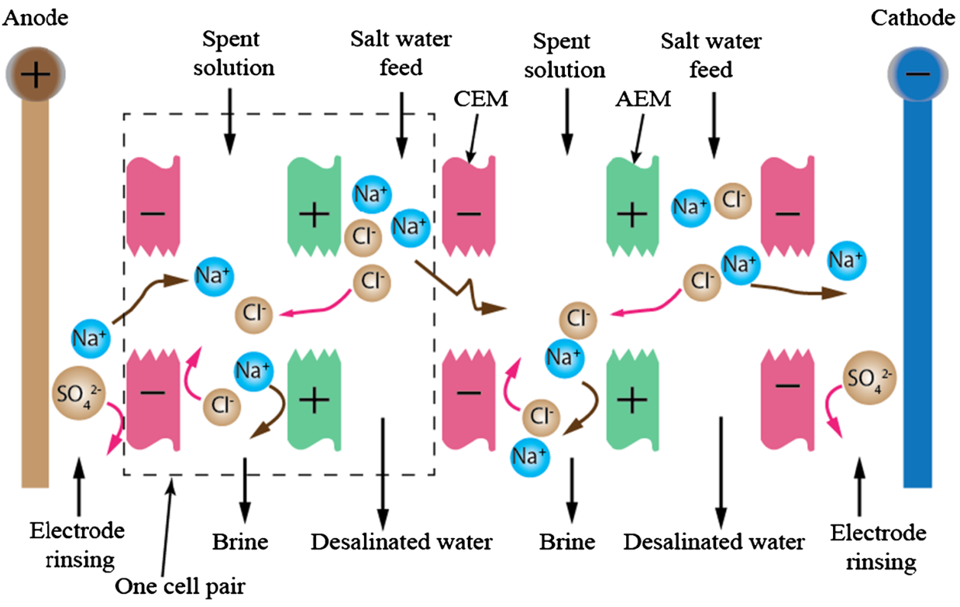
5 Potential question - patent - principle
[3]
[2]
Table. Comparison of different principles
Name | Principle | Advantage
Forward osmosis membranes | osmotic pressure difference between solution | Low energy consumption, low pollution, zero emission
Reverse osmosis membranes | pressure difference between both sides of membrane | Excellent water quality
Electrodialysis | Under the action of DC electric field force, the directional migration of anions and cations through the selective ion exchange membrane | 1. No pressure – low energy consumption 2. Low instances of membrane fouling 3. Mature and industrialized
[3] AccessScience Editors. “Forward osmosis allows using untreated water for renewable hydrogen production.” AccessScience, McGraw Hill, Mar. 2021.

Slide 32
5 Potential question - patent - equipment
Table. Equipment
Name | Model | Factory
conductivity meter | EC-510 | Shijiazhuang Jishen Tongchuang Technology Co., Ltd.
Peristaltic pump | DIPump550-B146 | Kamoer
Electronic balance | AUX-D series | Jutian Instrument Equipment Co., Ltd.
Digital pressure gauge | HLGK-Y100 | Yuyao Hangli Digital Instrument Factory
Forward osmosis membranes | FR-125 | Guochu Technology
Reverse osmosis cylindrical membrane | W-30HRLE-400/TM820-400 Roll | Guochu Technology
Electrodialysis | ED-55/110-2 | Zhejiang baichen low carbon technology Co., Ltd

Slide 33
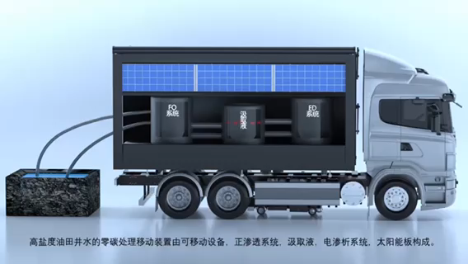
5 Potential question - patent - video

